Slide 1
Bottom-Up Parsing - I
Lecture 8
Section 4.5, 4.6
Rokan Uddin Faruqui
Associate Professor
Dept of Computer Science and Engineering University of Chittaong, Bangladesh Email: rokan@cu.ac.bd

Slide 2





Bottom-Up Parsing
LR Parsers
LR(0) Items
Building the PDA
Assignment
Bottom-Up Parsing - I

Slide 3





Outline
Bottom-Up Parsing
1
Bottom-Up Parsing
LR Parsers
LR(0) Items
4
Building the PDA
5 Assignment
Bottom-Up Parsing - I

Slide 4





Bottom-Up Parsing
E —> E + T | T T—>T * F | F
Bottom-Up Parsing
F—> (E) | id
A bottom-up parse corresponds to the construction of a parse tree for an input string beginning at the leaves (the bottom) and working up towards the root (the top).
E=>T=>T*F=>T*id=>F*id=>id*id
Figure: A bottom-up parse for id * id
Bottom-Up Parsing - I

Slide 5
Reductions
Bottom-Up Parsing
F —> id
E ==>* w
Bottom- up parsing is a process of reducing a string w to the start symbol of the grammar
At each reduction step, a specific substring matching the body of a production is replaced by the nonterminal at the head of that production.
The key decisions during bottom-up parsing are about
when to reduce
what production to apply
Bottom-Up Parsing - I

Slide 6





























Bottom-Up Parsing
Handle Pruning
Bottom-Up Parsing - I

Slide 7
Shift-Reduce Parser
Bottom-Up Parsing
Shift-reduce parsing is a form of bottom-up parsing in which a stack holds grammar symbols
an input buffer holds the rest of the string to be parsed initial configuration
STACK INPUT
$ w$
parser repeats this cycle until it has detected an error or until the stack contains the start symbol and the input is empty:
STACK INPUT
$S $
Bottom-Up Parsing - I

Slide 8

Shift-Reduce Parser
Bottom-Up Parsing
T-> T *F
Shift . Shift the next input symbol onto the top of the stack.
Reduce . The right end of the string to be reduced must be at the top of the stack. Locate the left end of the string within the stack and decide with what nonterminal to replace the string.
Accept . Announce successful completion of parsing.
Error . Discover a syntax error and call an error recovery routine.
Bottom-Up Parsing - I

Slide 9


LR Parsers
Outline
1
Bottom-Up Parsing
2 LR Parsers
3 LR(0) Items
4
Building the PDA
5 Assignment
Bottom-Up Parsing - I

Slide 10
LR Parsers
LR Parsers
A bottom-up parser follows a rightmost derivation from the bottom up.
Such parsers typically use an LR algorithm and are called LR parsers.
L means process tokens from Left to right.
R means follow a Rightmost derivation, albeit, in reverse order.
Bottom-Up Parsing - I

Slide 11
LR Parsers
LR Parsers
Furthermore, in LR parsing, the production is applied only after the pattern has been matched.
In LL (predictive) parsing, the production was selected, and then the tokens were matched to it.
Bottom-Up Parsing - I

Slide 12
Example
LR Parsers
Example (Rightmost Derivations) Let the grammar be
E → E + T | T
T → T * F | F F → ( E ) | id
Bottom-Up Parsing - I

Slide 13
Example
LR Parsers
Example (Rightmost Derivation of (id + id) ∗ id)
E ⇒ T
⇒ T *F
⇒ T *id
⇒ F *id
⇒ (E)*id
⇒ (E+ T )*id
⇒ (E+ F )*id
⇒ ( E+id)*id
⇒ ( T +id)*id
⇒ (F +id)*id
⇒ ( id+id)*id
Bottom-Up Parsing - I

Slide 14
LR Parsers
LR Parsers
An LR parser uses
A parse table (transition function)
An input buffer
A stack of “LR(0) states.”
Whereas a lexer is a DFA (deterministic finite automaton), an LR parser is a PDA (push-down automaton).
A PDA is essentially a DFA (or NFA) with a stack.
Bottom-Up Parsing - I

Slide 15
LR Parsers
LR Parsers
The parser performs three types of operation.
Shift a token from the input buffer to the stack.
Reduce the contents of the stack by applying a production. That is, pop a sequence of tokens that match the body of a production and replace them with the head of the production.
Go to a new state.
Bottom-Up Parsing - I

Slide 16
LR Parsers
LR Parsers
An LR(0) parser (0 lookahead) reduces as soon as the body of a production is matched, regardless of the next token.
An SLR parser (Simple LR) may or may not reduce, depending on the next token.
An LR(1) parser (1 lookahead) is more complicated. It incorporates the next token as part of the current “state” of the process.
An LALR parser (Look Ahead LR) is an LR(1) parser with its states much consolidated.
Bottom-Up Parsing - I

Slide 17

Outline
LR(0) Items
1
Bottom-Up Parsing
2 LR Parsers
[E —> .E + T]
[E —> E . +T]
[E —> E +.T]
[E —> E + T.]
3 LR(0) Items
4
Building the PDA
5 Assignment
Bottom-Up Parsing - I

Slide 18
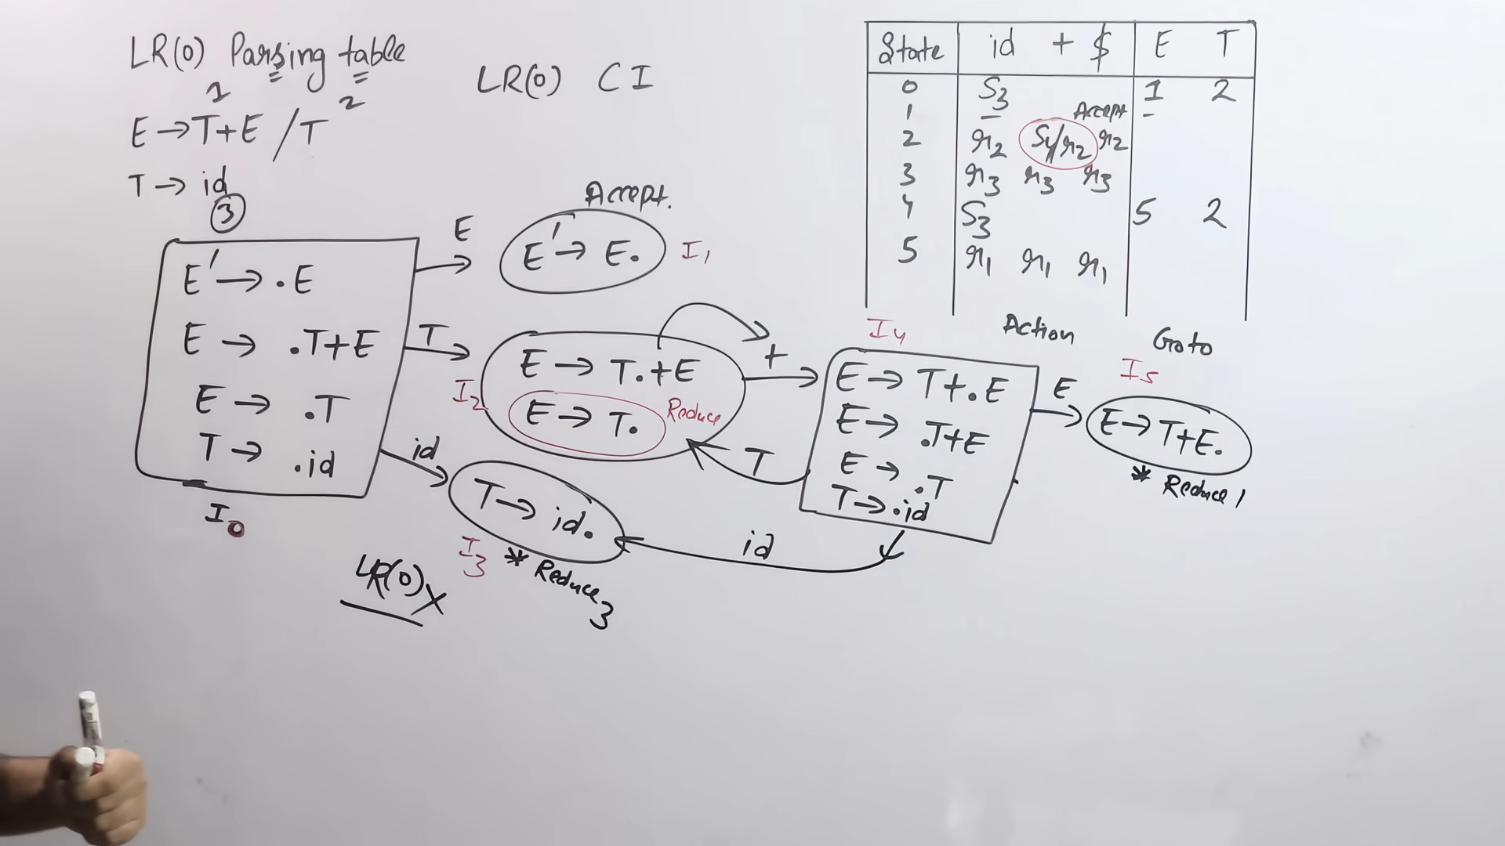
Lec-11: LR(0) Parsing Table | Check Whether a Grammar is LR(0) or not | Bottom-Up Parser

Slide 19
jodi action collumn a eki cell a shift and reduce Or reduce and reduce ase tobe not LR(0)

Slide 20
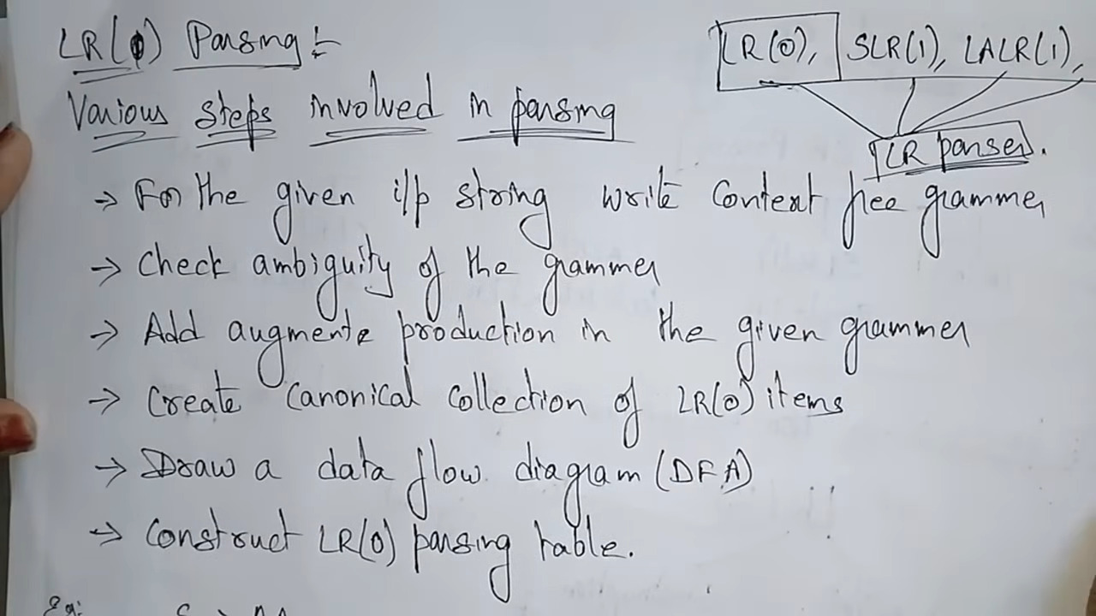

Slide 21
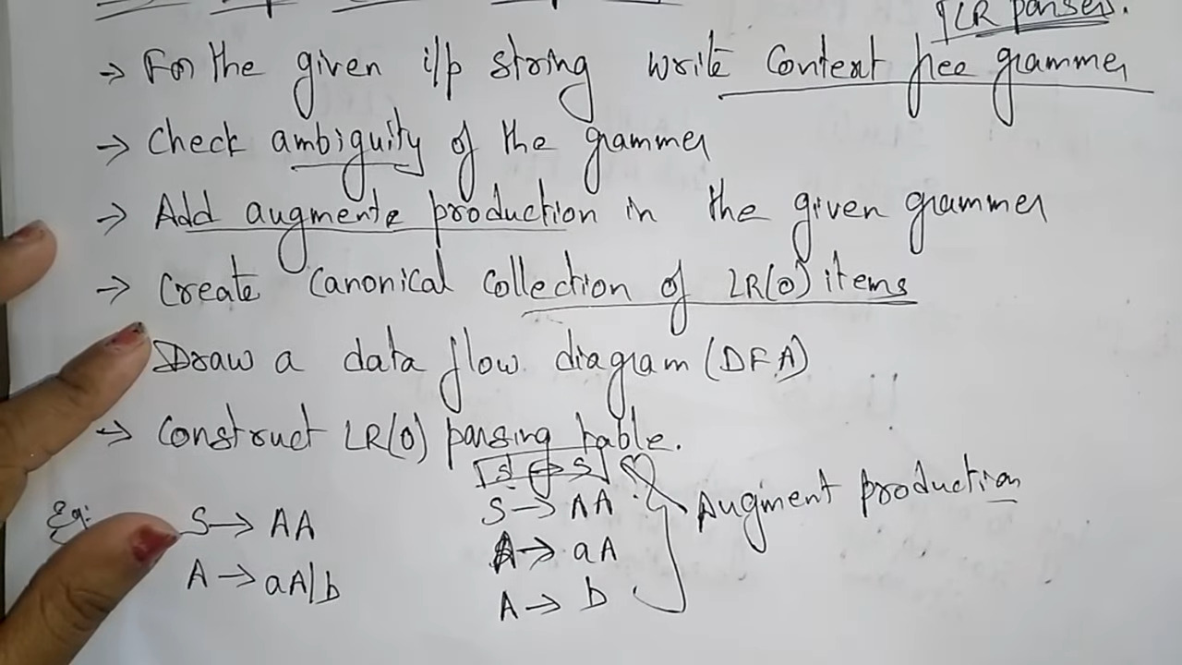

Slide 22
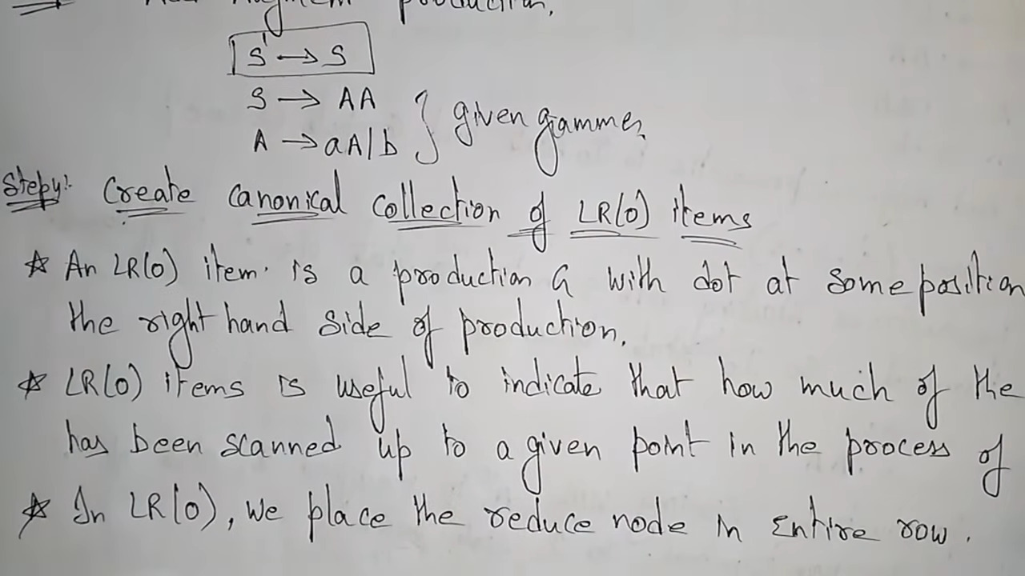

Slide 23
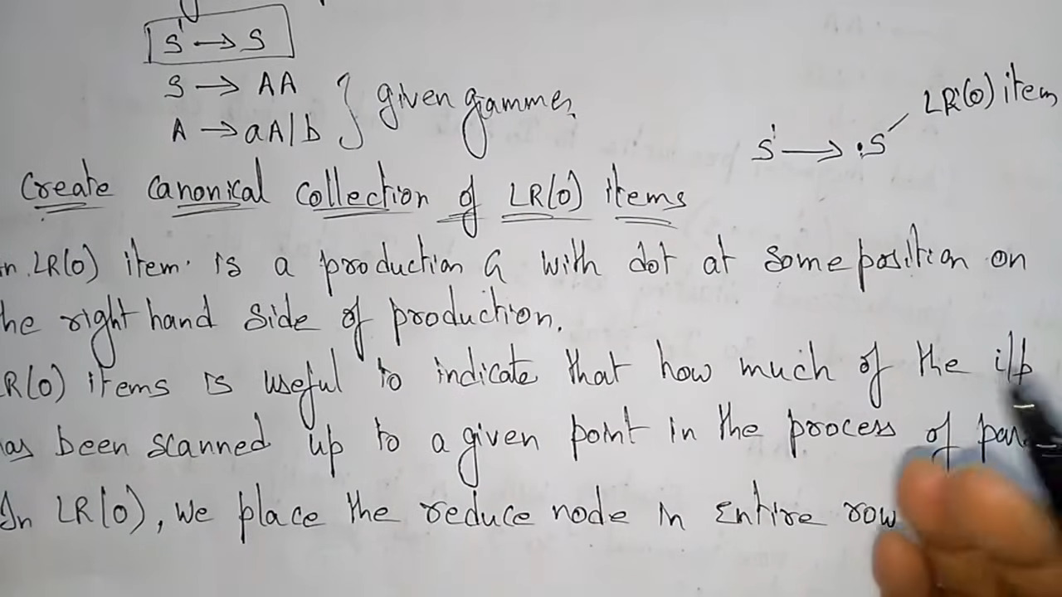

Slide 24
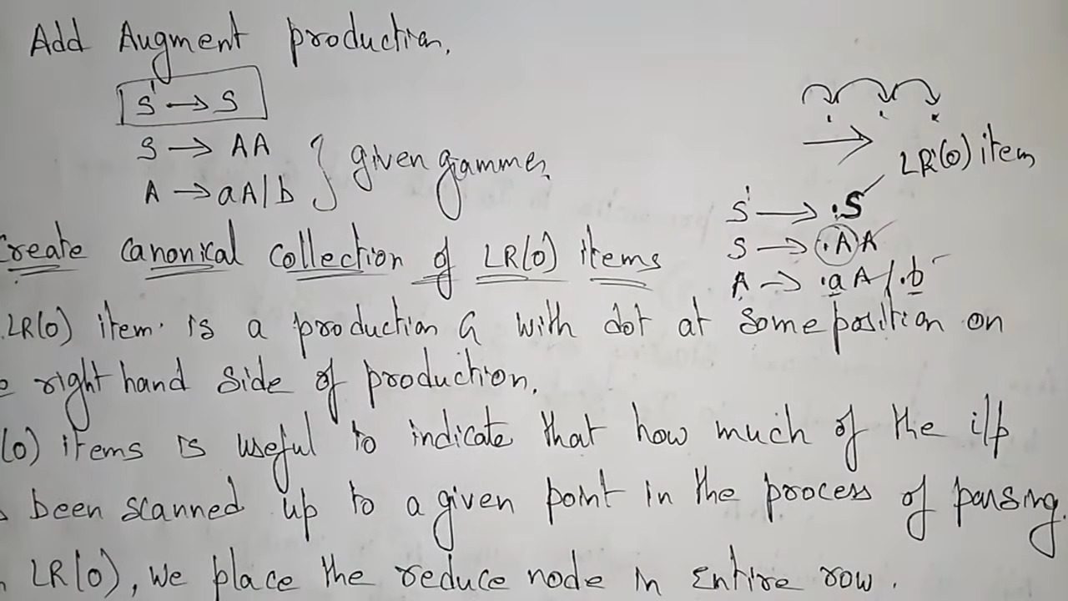

Slide 25
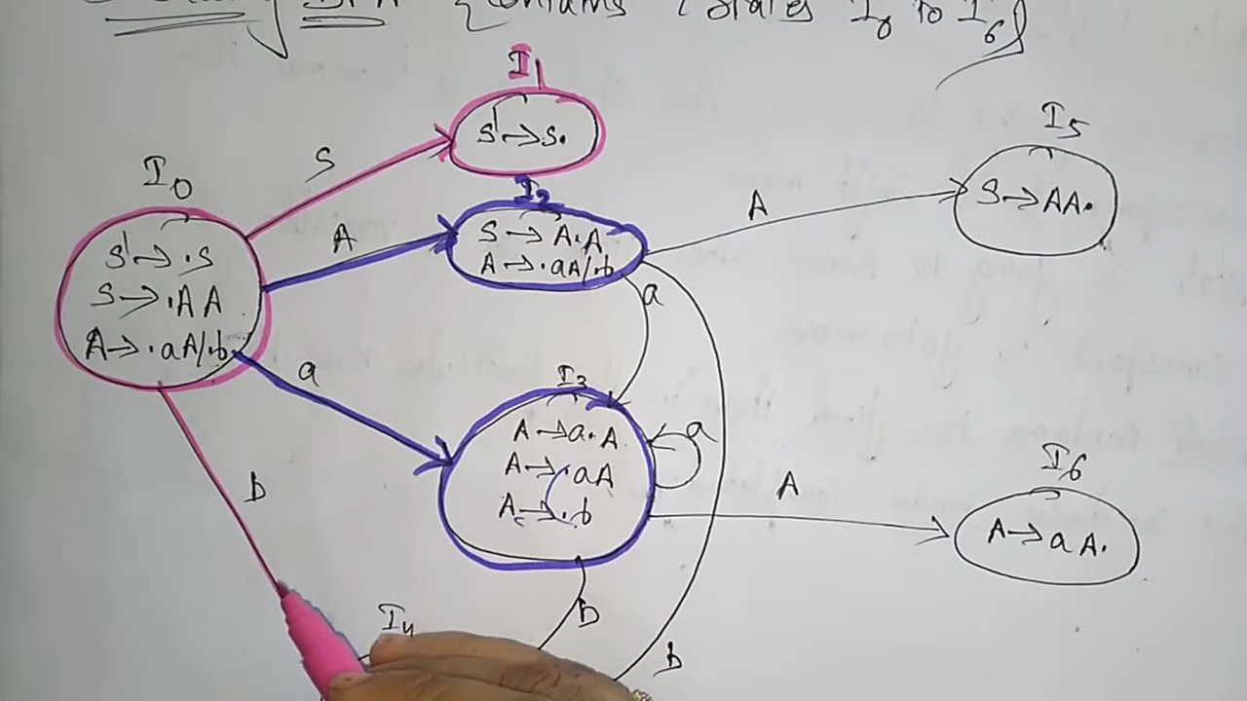

Slide 26
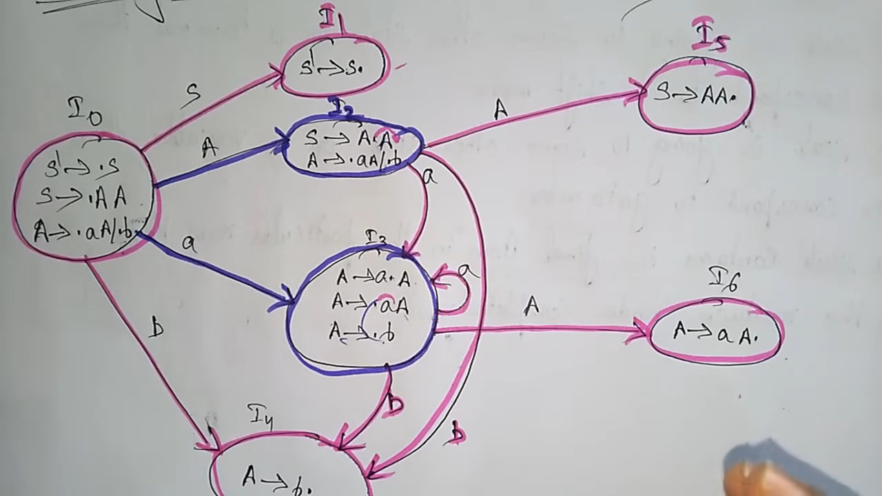
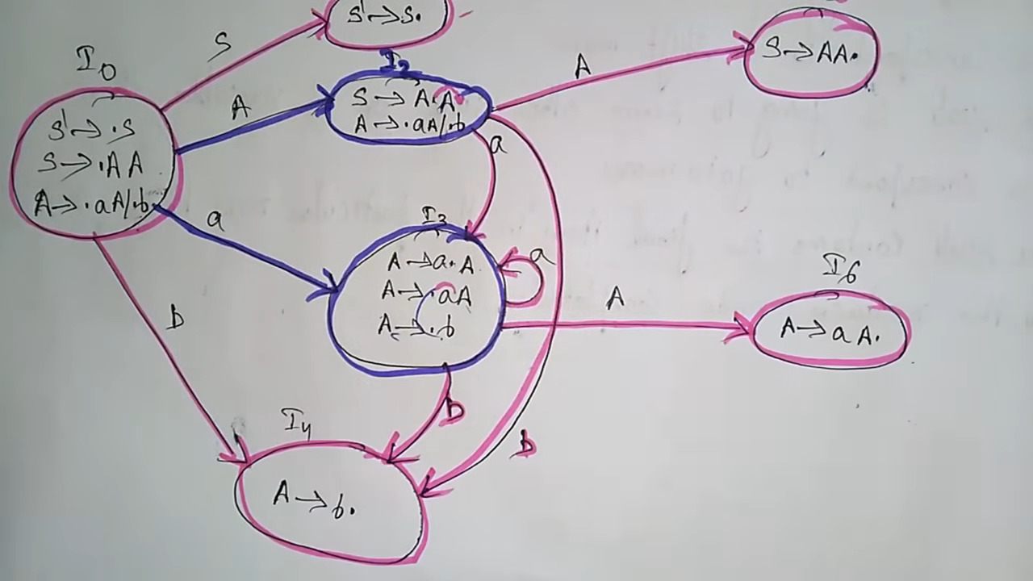

Slide 27
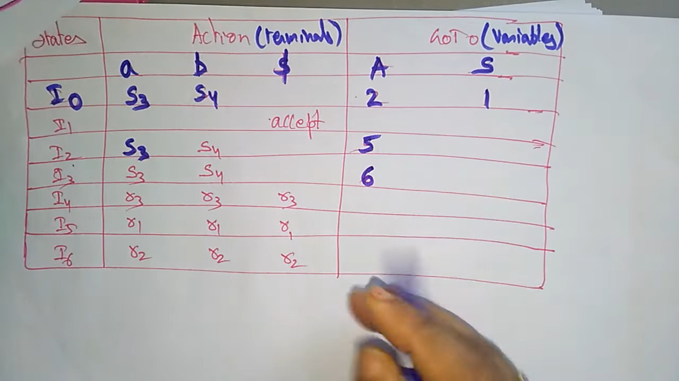
parse table

Slide 28
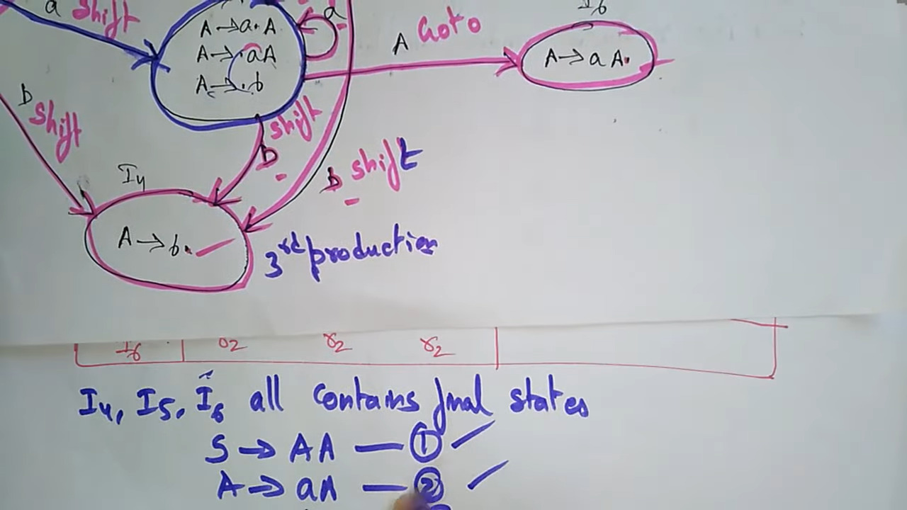

Slide 29
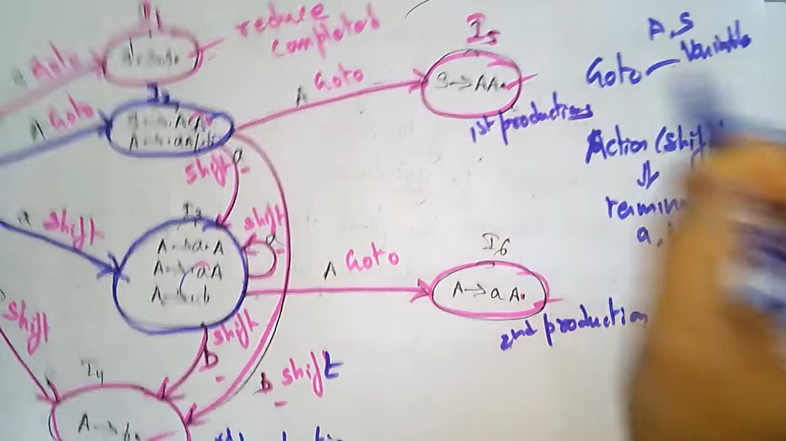

Slide 30
S->AA 1
A->aA 2
A-> b 3

Slide 31
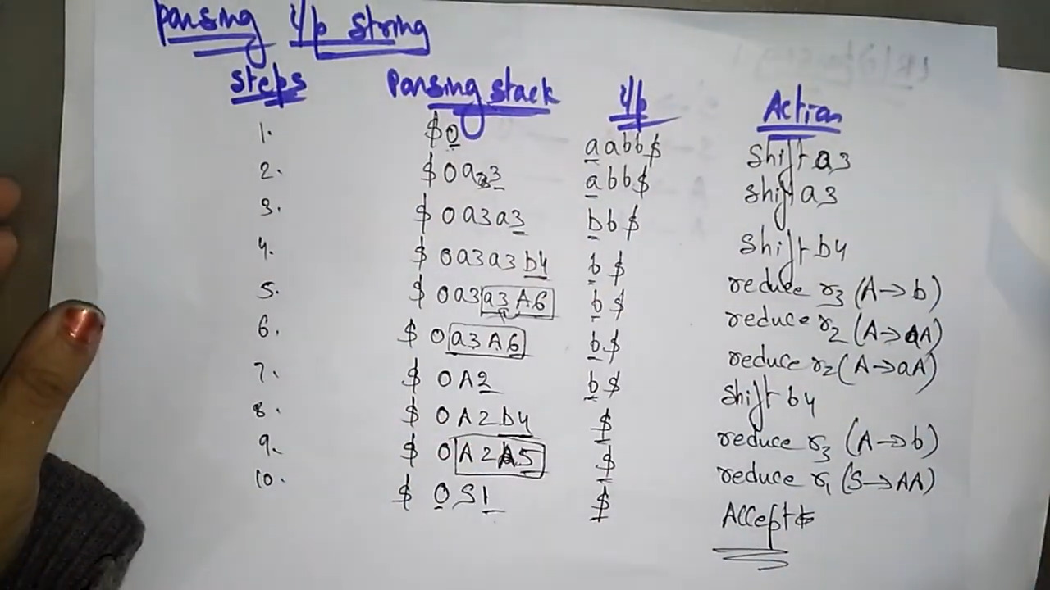
LR (0) parsing | Input string | Part-3/3 |

Slide 32
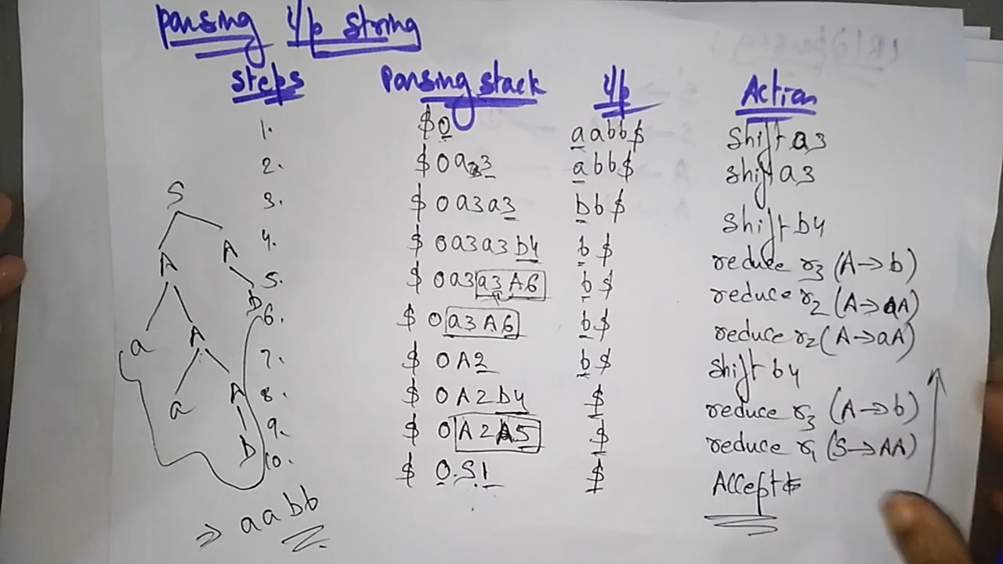

Slide 33
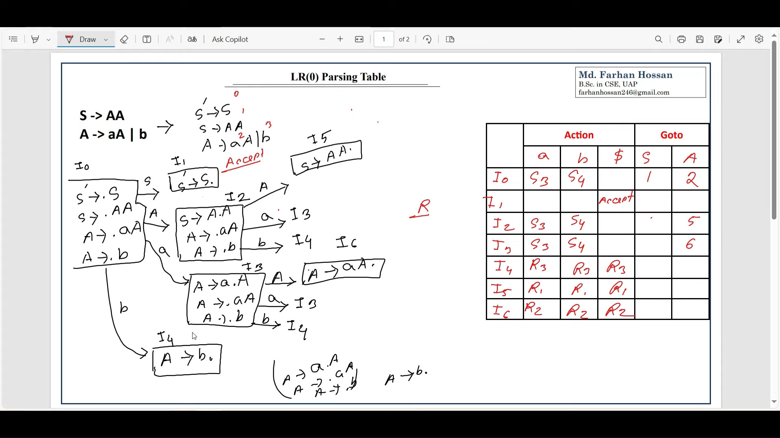

Slide 34
LR(0) Items
LR(0) Items
A —> .BcD A —> B.cD A —> Bc.D A —> BcD.
E —> . E + T E —> E . + T E —> E + .T E—> E+T.
Definition (LR(0) item)
An LR(0) item is a production with a special marker (•) that marks a position within the body of the production.
To build an LR parse table, we must first find the LR(0) items.
Bottom-Up Parsing - I

Slide 35
Example
LR(0) Items
Example (LR(0) Items) If the production is
E → E + T,
then the possible LR(0) items are
[E → • E + T ]
[E → E • + T ] [E → E + • T ] [E → E + T •]
Bottom-Up Parsing - I

Slide 36
LR(0) Items
LR(0) Items
E —> E + .T E —> E + T.
The interpretation of [A → α • β] is
“We have processed α and we might process β next.”
Whether we do actually process β will be borne out by the subsequent tokens.
Bottom-Up Parsing - I

Slide 37

Outline
Building the PDA
1
Bottom-Up Parsing
LR Parsers
LR(0) Items
4
Building the PDA
5 Assignment
Bottom-Up Parsing - I

Slide 38
LR Parsing
Building the PDA
E’ —> E
E —> E+T|T
We will build a PDA whose states are sets of LR(0) items. First we augment the grammar with a new start symbol S′.
S′ → S
Bottom-Up Parsing - I

Slide 39
States of the PDA
Building the PDA
{ [E’ —> .E]}
The initial state is called I₀ (item 0). State I₀ is the closure of the set
{[S′ → • S]}.
S —> A
A —
To form the closure of a set of items
For each item [A → α • Bβ] in the set and for each production
B → γ in the grammar, add the item [B → • γ] to the set.
Continue in this manner until there is no further change.
We will call [B → • γ] an initial B-item.
Bottom-Up Parsing - I

Slide 40

Example
Building the PDA
Example (LR Parsing)
E
Continuing with our example, the augmented grammar is
E′ → E
E → E + T | T
T → T * F | F F → ( E ) | id
Bottom-Up Parsing - I

Slide 41
Example
Building the PDA
Example (The PDA States)
The state I₀ consists of the items in the closure of item [E′ → • E].
I₀
E′ → • E
E → • E + T
E → • T
T → • T * F
T → • F
F → • ( E )
F → • id
Bottom-Up Parsing - I

Slide 42
Transitions
Building the PDA
There will be a transition from one state to another state for each grammar symbol that immediately follows the marker • in an item in that state.
If the item [A → α • Xβ] is in the state, then
A transition from that state occurs when the symbol X is processed.
The transition is to the state that is the closure of the item
[A → αX • β].
Bottom-Up Parsing - I

Slide 43
Example
Building the PDA
Example (Building the PDA)
Thus, from the state I₀, there will be transitions for the symbols
E, T , F , (, id, and num.
For example, on processing E, the items
[E′ → • E] and [E → • E + T ]
become
[E′ → E •] and [E → E • + T ].
Bottom-Up Parsing - I

Slide 44
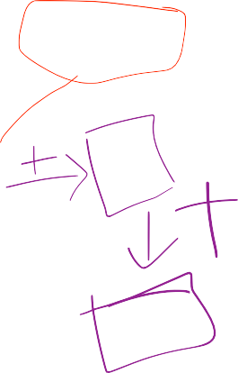

Building the PDA
Example
E —> E + T.
E —> E + . T T—> .T * F T —>. F
F —> .(E)
F—> id
Example (Building the PDA)
Let state I be the closure of these items.
1
I₁
E—> E +.T
S′ → E •
E → E • + T
Then the PDA has the transition
E
E -> E + T.
I₀
I₁
Bottom-Up Parsing - I

Slide 45
Example
Building the PDA
Example (Building the PDA)
Similarly we determine the other transitions from I₀.
On T | On F
I₂ | I₃
E → T • T → T • * F | T → F •
Bottom-Up Parsing - I

Slide 46
Building the PDA
Example
Example (Building the PDA)
On ( | On id
I₄ | I₅
F → ( • E ) E → • E + T E → • T T → • T * F T → • F F → • ( E ) F → • id | F → id •
Bottom-Up Parsing - I

Slide 47
Example
Building the PDA
Example (Building the PDA)
Now find the transitions from states I₁ through I₅ to other states, and so on, until no new states appear.
Bottom-Up Parsing - I

Slide 48


Building the PDA
Example
Example (Building the PDA)
On + | On * | On E
I₆ | I₇ | I₈
E → E + • T T → • T * F T → • F F → • ( E ) | T → T * • F F → • ( E ) F → • id | F → ( E • ) E → E • + T
F → • id
F —> (E).
Bottom-Up Parsing - I

Slide 49
Building the PDA
Example
r5 FOLLOW(F) = {+, *, $, ) }
Example (Building the PDA)
On T | On F | On )
I₉ | I10 | I11
E → E + T • T → T • * F | T → T * F • | F → ( E ) •
Bottom-Up Parsing - I

Slide 50
Building the PDA
Example
Example (Building the PDA)
 |  | To
 |  | I0 | I1 | I2 | I3 | I4 | I5 | I6 | I7 | I8 | I9 | I10 | I11
From | I0 |  | E | T | F | ( | id
 | I1 |  |  |  |  |  |  | +
 | I2 |  |  |  |  |  |  |  | *
 | I3
 | I4 |  |  | T | F | ( | id |  |  | E
 | I5
 | I6 |  |  |  | F | ( | id |  |  |  | T
 | I7 |  |  |  |  | ( | id |  |  |  |  | F
 | I8 |  |  |  |  |  |  | + |  |  |  |  | )
 | I9 |  |  |  |  |  |  |  | *
 | I10
 | I11
The transition table
Bottom-Up Parsing - I

Slide 51
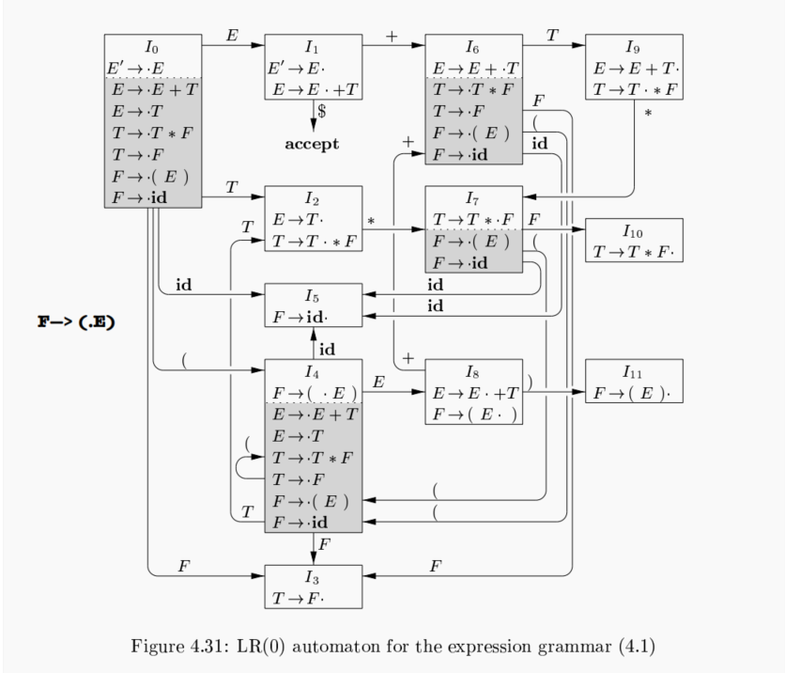

Slide 52

Outline
Assignment
1
Bottom-Up Parsing
LR Parsers
LR(0) Items
4
Building the PDA
5 Assignment
Bottom-Up Parsing - I

Slide 53
Assignment
Assignment
Homework
Let the grammar be
E → E + E | E * E | ( E ) | id
Write the LR(0) items for this grammar. Write the LR(0) states.
Draw the transition diagram for the PDA of an SLR parser. (continued…)
Bottom-Up Parsing - I

Slide 54
Assignment
Assignment
Homework
Let the grammar be
S → ( L ) | id
L → L , S | S
Write the LR(0) items for this grammar. Write the LR(0) states.
Draw the transition diagram for the PDA of an SLR parser.
Bottom-Up Parsing - I

